Slide 1
Exploding Snowmen!
An exploration of chemical reactions and cause and effect.

Slide 2
Watch the experiment by clicking this link. Snowman Video

Slide 3
How To Try This At Home
You may want to do this experiment in the shower or outside if it’s not too cold so you don’t end up with a mess.

Slide 4
Materials
A sandwich bag (That seals)
Permanent markers (to draw a snowman face)
3 teaspoons baking soda
1 – 2 cups of white vinegar
Paper towel or tissue paper (tissue paper results in a faster explosion)

Slide 5
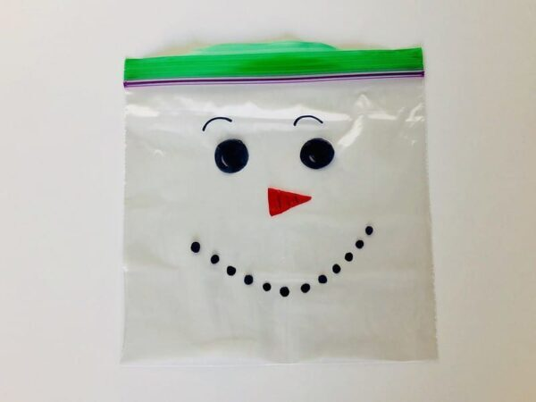
How To:
Draw a snowman face on your bag

Slide 6
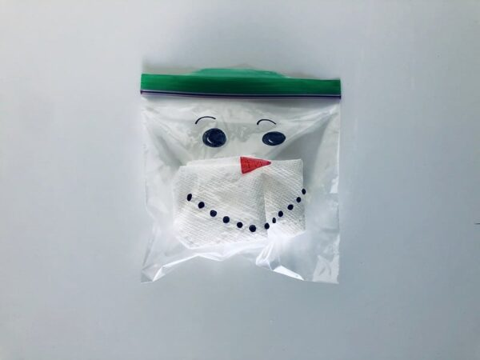
Wrap 3 teaspoons of baking soda in a paper towel or tissue, place inside the bag.

Slide 7
Pour vinegar into the bag and quickly seal. It will expand very fast.

Slide 8
What Happened and Why
As baking soda, or sodium bicarbonate, mixes with vinegar, carbon dioxide is created. The bag starts to fill with carbon dioxide (and that’s why you see the bag start to swell up) until the pressure is too much and … BOOM!

