Slide 1
Snowman Math
Counting Backwards, Introduction to Subtraction

Slide 2
5 Little Snowmen
Click on the snowman to hear a snowman counting song

Slide 3
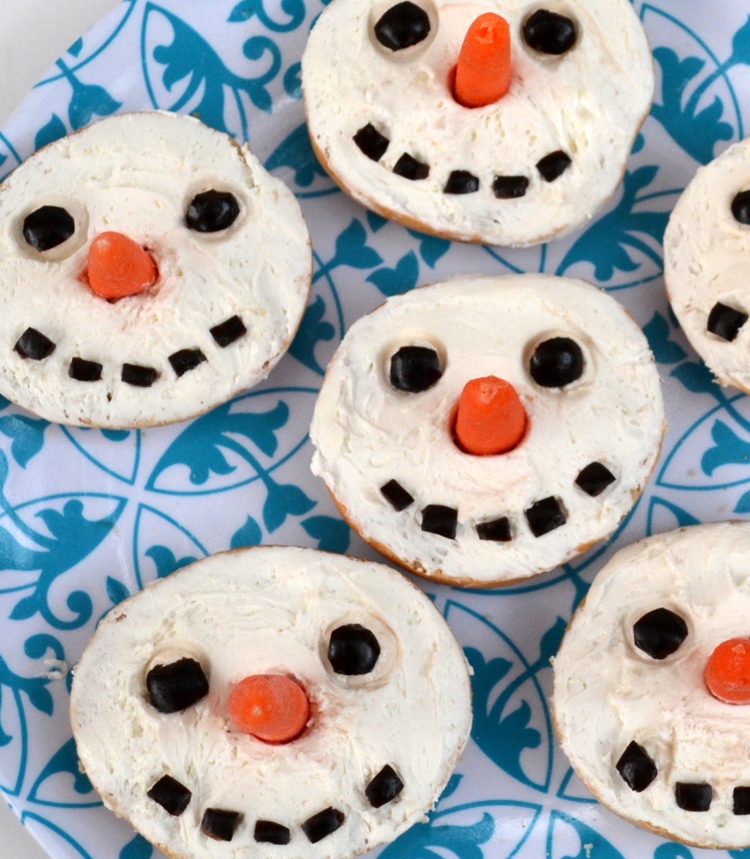
Counting Backwards
Find 10 items that you can pretend are snowmen, or crumple up 10 pieces of paper to be snowballs
Start at 10 and count backwards as you take items away.
Practice subtraction skills by taking 2 snowmen away. Count how many are left.
Try again this time take 3 away. Count how many are left.
Keep going for as long as you want.

